Slide 1
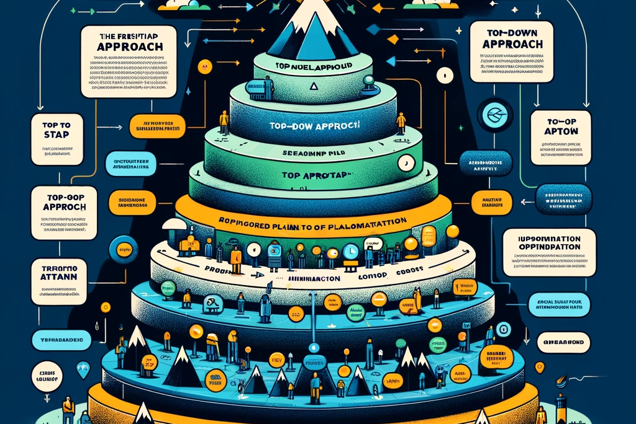
Topdown approach
A Guide to Effective Problem-Solving

Slide 2

Agenda
What is Top-Down Approach
Why use the Top-Down Approach
Who can benefit from the Top-Down approach
How to implement the Top-Down approach in projects

Slide 3
Introduction
With PowerPoint, you can create presentations and share your work with others, wherever they are. Type the text you want here to get started. You can also add images, art, and videos on this template. Save to OneDrive and access your presentations from your computer, tablet, or phone. ​

Slide 4

What is Top-Down approach ?
Is a method commonly used in various fields like software development, project management, and systems engineering, among others.

Slide 5

What is Top-Down approach ?
Starting from the highest level of conceptual detail.
Progressively breaking down into more detailed and specific components.

Slide 6
Table
 | Category 1 | Category 2 | Category 3 | Category 4
Item 1 | 4.5 | 2.3 | 1.7 | 5
Item 2 | 3.2 | 5.1 | 4.4 | 3
Item 3 | 2.1 | 1.7 | 2.5 | 2.8
Item 4 | 4.5 | 2.2 | 1.7 | 7

Slide 7

THE WAY TO GET STARTED IS TO QUIT TALKING AND BEGIN DOING.
Walt Disney

Slide 8




Team
Name
Name
Name
Name
Title
Title
Title
Title

Slide 9
Timeline
Title
To start a presentation, go to the Slide Show tab, and select From Beginning.
Title
To display Presenter view, in Slide Show view, on the control bar at the bottom left select the three dots, and then Show Presenter View.
Title
During your presentation, the speaker notes are visible on your monitor, but aren't visible to the audience.
Title
Title
The Notes pane is a box that appears below each slide. Tap it to add notes.
If you don’t see the Notes pane or it is completely minimized, click Notes on the task bar across the bottom of the PowerPoint window.

Slide 10
Content
Subtitle
Subtitle
Add text, images, art, and videos.
Add transitions, animations, and motion.
Save to OneDrive, to get to your presentations from your computer, tablet, or phone.
Add text, images, art, and videos.
Add transitions, animations, and motion.
Save to OneDrive, to get to your presentations from your computer, tablet, or phone.

Slide 11
Content 2
Subtitle
Subtitle
Subtitle
Add text, images, art, and videos.
Add transitions, animations, and motion.
Save to OneDrive, to get to your presentations from your computer, tablet, or phone.
Add text, images, art, and videos.
Add transitions, animations, and motion.
Save to OneDrive, to get to your presentations from your computer, tablet, or phone.
Add text, images, art, and videos.
Add transitions, animations, and motion.
Save to OneDrive, to get to your presentations from your computer, tablet, or phone.

Slide 12



Summary
With PowerPoint, you can create presentations and share your work with others, wherever they are. Type the text you want here to get started. You can also add images, art, and videos on this template. Save to OneDrive and access your presentations from your computer, tablet, or phone.

Slide 13


THANK YOU
Presenter Name
Email
Website

